Slide 1
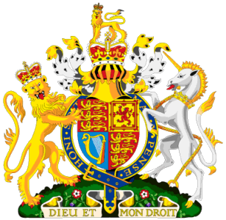
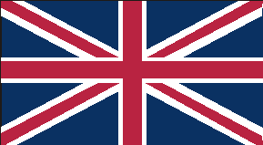
THE UNITED KINGDOM OF GREAT BRITAIN AND NORTHERN IRELAND

Slide 2
The UK consists of
England (the capital is London)
Wales (the capital is Cardiff)
Scotland (the capital is Edinburgh)
Northern Ireland (the capital is Belfast).
The territory of the UK is about 244,000 square kilometres.
The population is over 56,5 million.

Slide 3
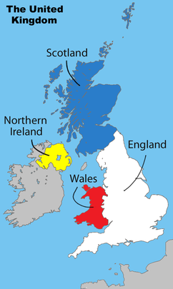
The United Kingdom of Great Britain and Northern Ireland
The full name of the country is the United Kingdom of Great Britain and Northern Ireland.
It consists of four parts: England, Wales, Scotland and Northern Ireland.

Slide 4
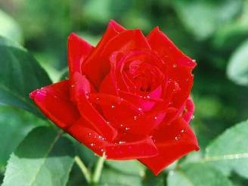
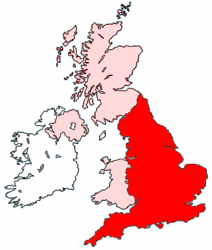
England
England is the largest and the richest country of Great Britain.
The capital of England is London.
The symbol of England is the rose.

Slide 5
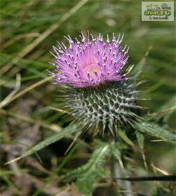
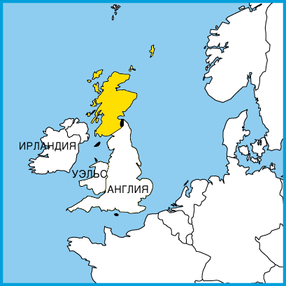
Scotland
Scotland is a country in the north of Great Britain.
The capital of Scotland is Edinburgh.
The symbol of Scotland is the thistle.

Slide 6
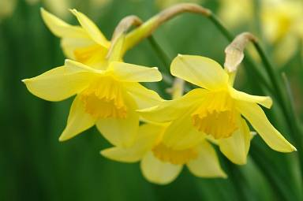
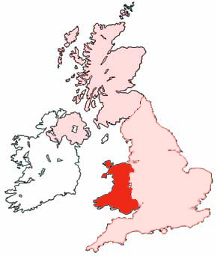
Wales
Wales is the country in the west of Great Britain.
The capital of Wales is Cardiff.
The symbol of Wales is the daffodil.

Slide 7
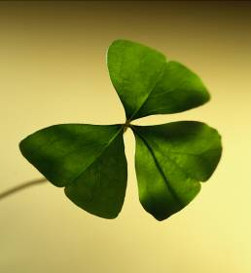
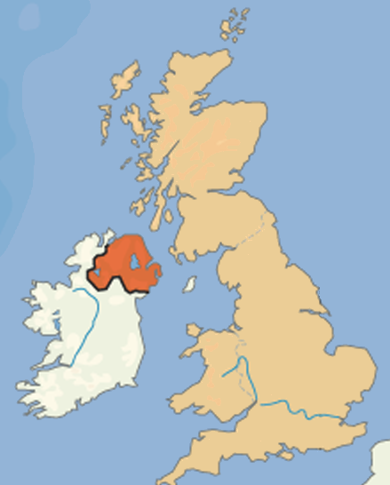
Northern Ireland
Northern Ireland is situated in the north-east of the island of Ireland.
The capital of Northern Ireland is Belfast.
The symbol of Northern Ireland is the shamrock.

Slide 8
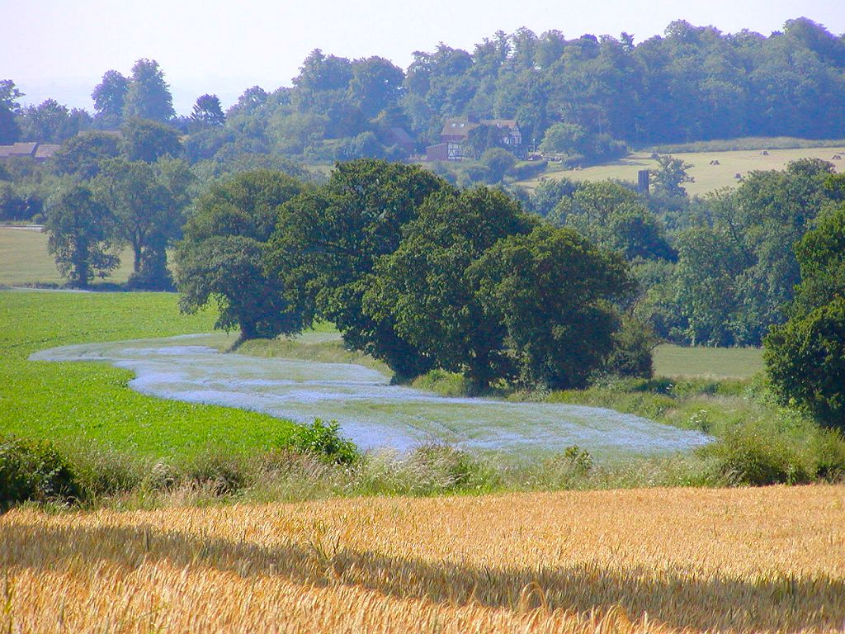
The climate is
mild the whole year round. The Atlantic Ocean, the warm waters of the Gulf Stream influence the climate.

Slide 9
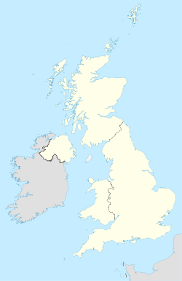
Edinburgh
Glasgow
Manchester
Liverpool
London

Slide 10
Edinburgh

Slide 11
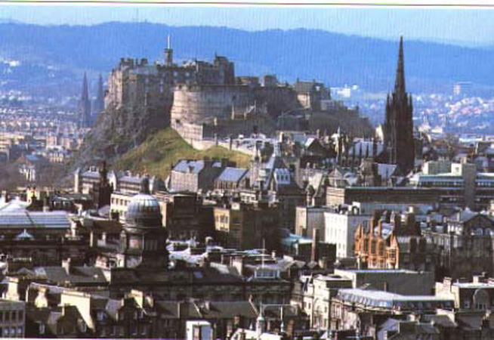
Edinburgh
Capital of Scotland
Coastal city

Slide 12
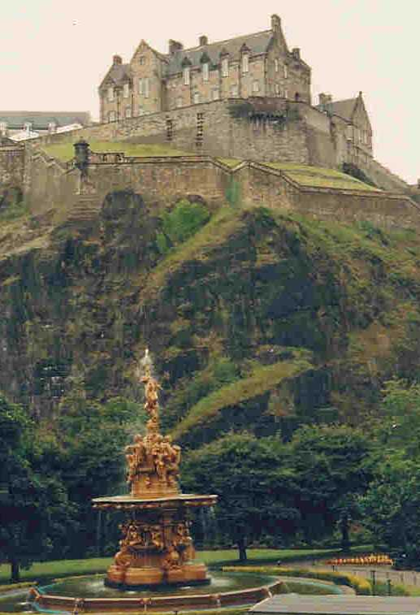
Sights of Edinburgh

Slide 13
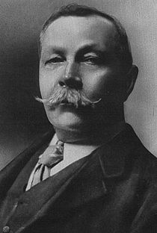
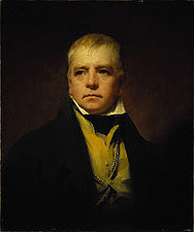
Famous people
Walter Scott
Sir Arthur Ignatius Conan Doyle

Slide 14
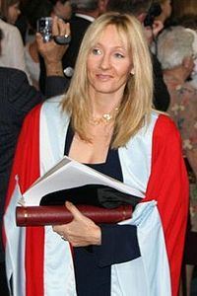
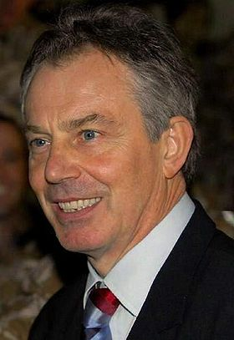
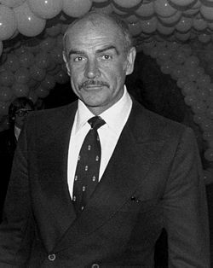
Famous people
Joanne Rowling
Sir Sean Connery
Tony Blair

Slide 15
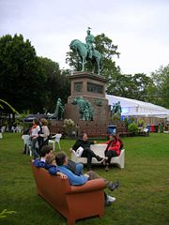
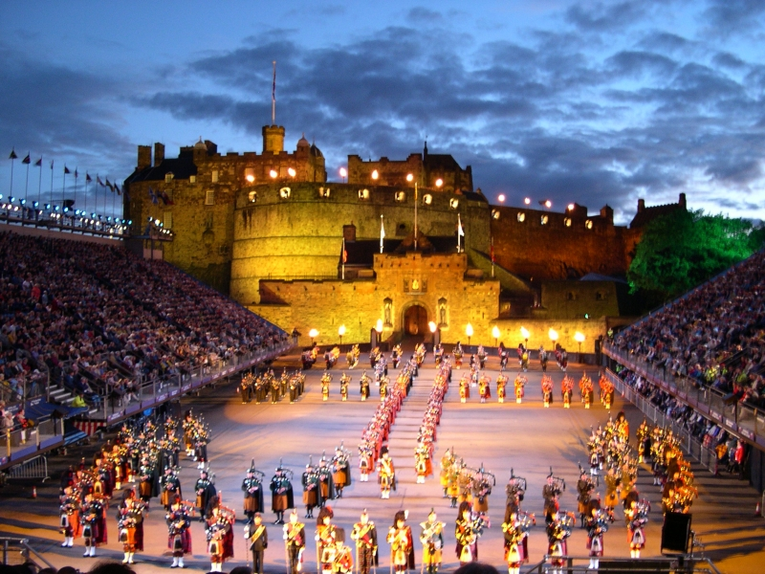
Traditions and Customs
Annual Summer Festival
International Edinburgh
Book Festival

Slide 16
Edinburgh
Glasgow

Slide 17
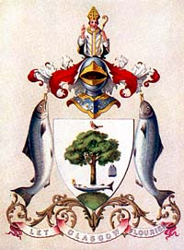
Glasgow
Compaq
Scotland’s largest city
Fishing
Harbour city

Slide 18
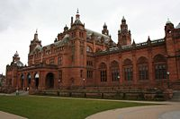
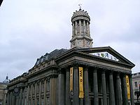
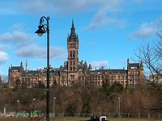
Sights of Glasgow
Glasgo Gallery of Modern Art
Celvin Grove Art Gallery
Glasgo University

Slide 19
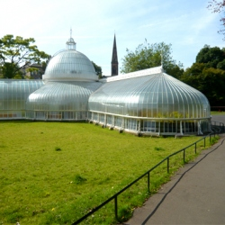
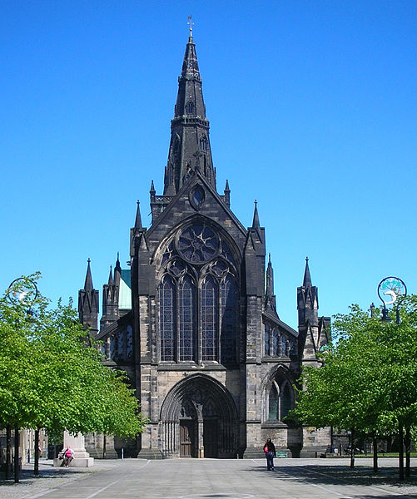
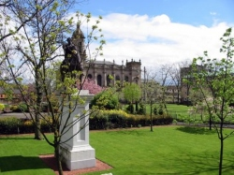
Sights of Glasgow
Glasgow Botanical Garden
Glasgow Abbey
Glasgow Green

Slide 20
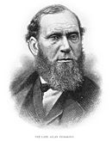
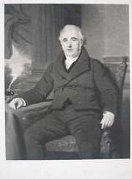
Famous people
Allan Pincerton
Charles Macintosh

Slide 21
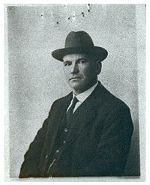
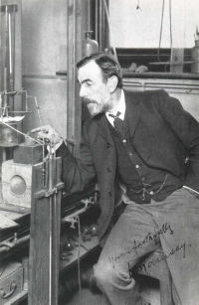
Famous people
John Maclean
Sir William Ramsay

Slide 22
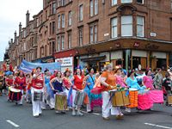

Traditions and Customs
West End Festival
Annual Music Festival

Slide 23
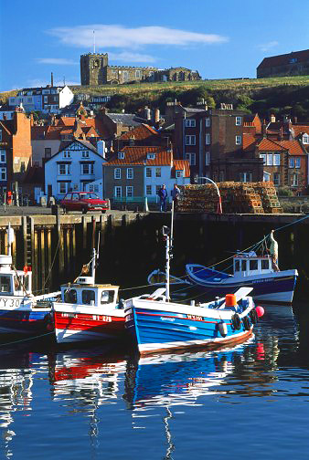
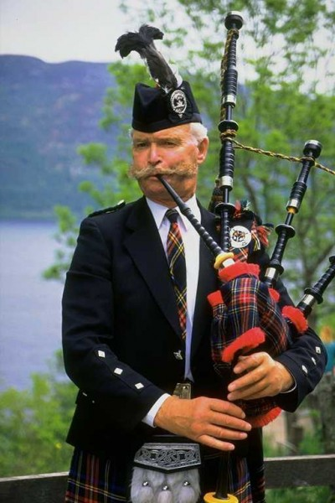
Traditions and Customs
Bagpipe Festival
Annual Boat Race Festival

Slide 24
Edinburgh
Glasgow
Liverpool

Slide 25
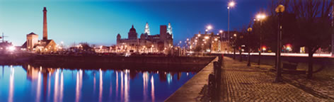
  Liverpool
Capital of culture
The Beatles
Sunday talents
Festival city

Slide 26

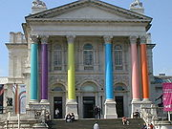

Sights of Liverpool
Tate Gallery
St. Georges Hall
Everton Water Tower

Slide 27
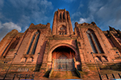
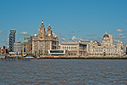
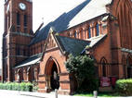
Sights of Liverpool
Liverpool Anglican Cathedral
Liverpool Waterfront and
New Ferry Terminal
St. Luke’s Church

Slide 28
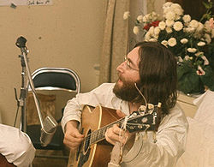
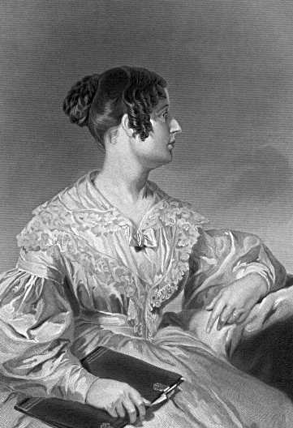
Famous people
John Lennon
Felicia Hemmans

Slide 29
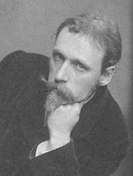
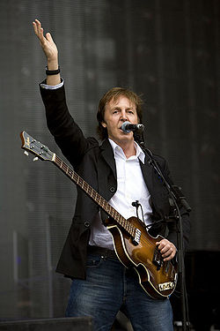
Famous people
Walter Crane
Paul MacCartney

Slide 30
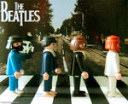
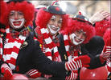
Traditions and Customs
Street Festival
Annual
Beatles Festival

Slide 31
Edinburgh
Glasgow
Manchester
Liverpool

Slide 32
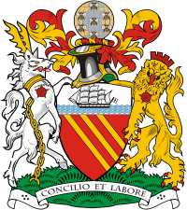
Manchester
10% of workers
Significant financial sector
The highest weekly earnings-£420.40
Manchester United
Celvin Grove Art Gallery

Slide 33
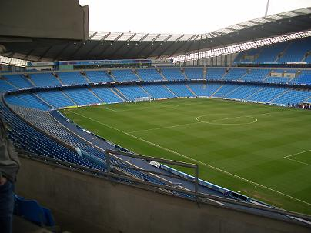
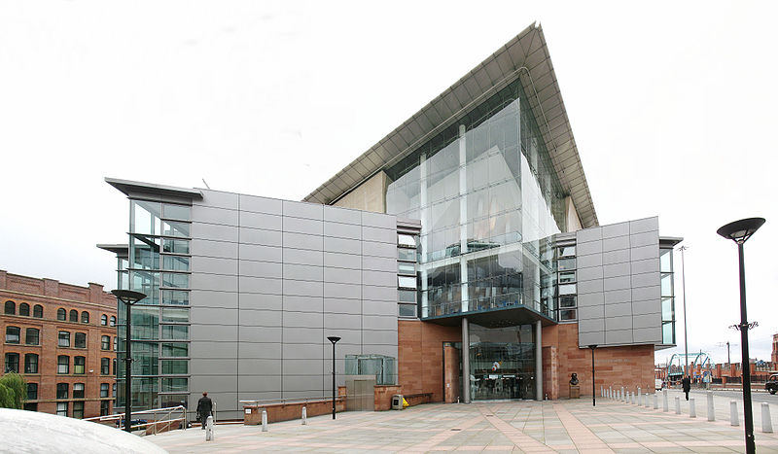
Sights of Manchester
City of Manchester
Stadium
Bridgewater Hall

Slide 34


Sights of Manchester
Manchester Piccadilly
station
Manchester Opera House

Slide 35


Famous people
David-Beckham
John Everett Mille

Slide 36
Edinburgh
Glasgow
Manchester
Liverpool
London

Slide 37

London
The capital of England
Modern city
One of the most famous marvelous cities

Slide 38


Sights of London
Tower bridge
Houses of Parliament

Slide 39

Sights of London
St Paul’s Cathedral

Slide 40


Famous people
Elizabeth II
Hugh Grant

Slide 41



Traditions and Customs
Osterbrunnen
New Year

