Slide 1
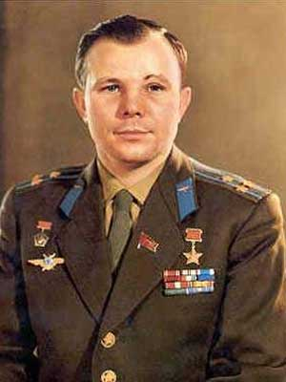
Yuri Gagarin (1934-1968)

Slide 2
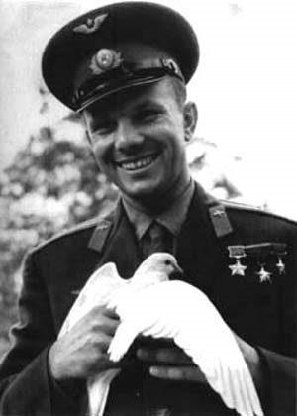
Yuri Gagarin’s name,the name of the first cosmonaut is known to everybody. His life and work are a great example to all young people.
Yuri Alexeyevich Gagarin was born in the village of Klushino in the Smolensk region on March 9,1934, into the family of a collective farmer. In 1951 he graduated from a vocation school in the town of Lyubertsy, near Moscow, and the same time he finished an evening school.

Slide 3
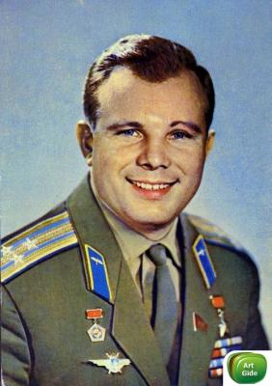
When he was a schoolboy, his favorite subjects were physics and mathematics. He read a lot of books.
Yuri Gagarin began to fly while he was a student of a technical secondary school in Saratov. He was a member of an aeroclub.
In 1955,he entered a flying school. Two years later he became a pilot and soon he joined the first group of Soviet cosmonauts.
In the summer of 1960 Yuri Gagarin joined the Communist Party. That was the most important day of his life.

Slide 4
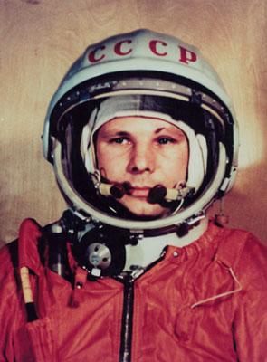
On April 12, 1961, Yuri Gagarin flew into space for the first time in history. He spent 108 minutes there.
When he came back in his spaceship Vostok, he was made a Hero of the Soviet Union and awarded the Order of Lenin and the Gold Star Medial.

Slide 5
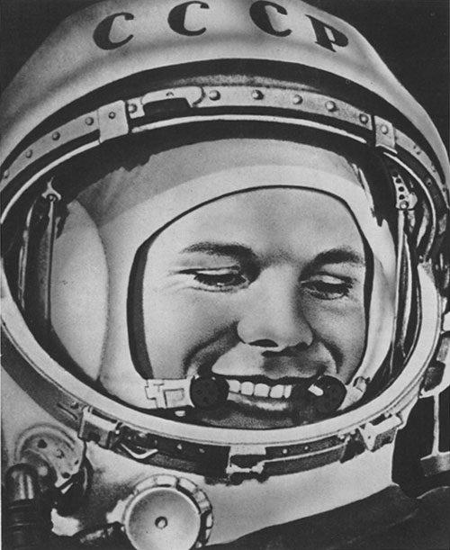
Yuri Gagarin visited many countries. Million of people saw him and listened to him. They greeted him as a great him patriot of the Soviet land. Yuri Alexeyevich Gagarin was commander of the cosmonaut group, he prepared to fly in a new spaceship. He did not go into space again, but the people will always remember him as the world first space pilot, a Soviet hero.

