Slide 1
Writing an informal letter
Spotlight 8
Module 2
Unit 2e

Slide 2
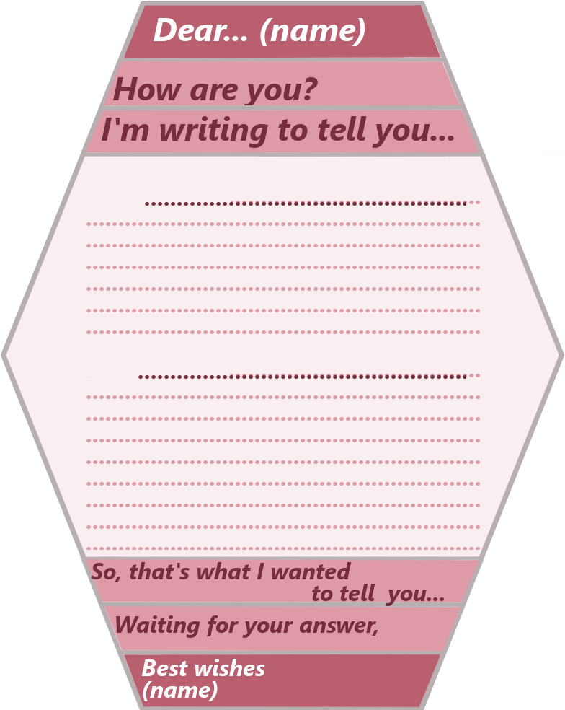

Slide 3
An informal greeting
An opening remark
Reason for writing
Introduction
topic
sentence
body
Main
Conclusion
Summing up
A closing remark
An informal ending

