Slide 1









When do English
people celebrate
Christmas?

Slide 2


Christmas Day is on the 25th of December. It is the greatest holiday in Britain. English people celebrate this holiday with big dinners. Children have a lot of fun. They play under Christmas trees, find presents in their Christmas stockings, eat Christmas pudding, watch pantomimes. The grown-ups don’t work on that day.

Slide 3

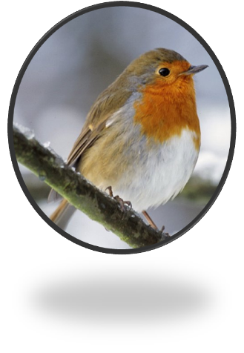
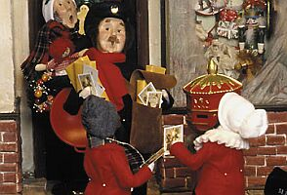
Many years ago postmen had bright red coats. They looked like robins. At Christmas they brought many Christmas cards. And people began to think about a robin as a Christmas bird. You can see it on almost every Christmas card.

Slide 4

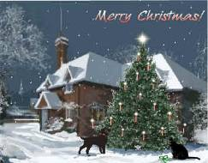
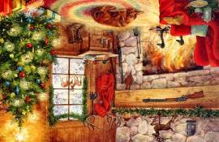
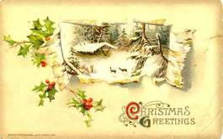
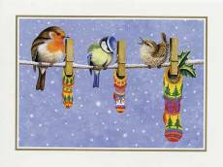

Every English family sends and receives many Christmas cards. Traditionally there is a robin on almost every card. And you know already that a robin is a Christmas bird. Sometimes there is a bunch of holly on the Christmas card. You can read on the card: “Merry Christmas!”

Slide 5

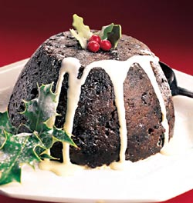
Christmas pudding was first made many, many years ago. Now it is the highlight of Christmas dinner. Children often put holly on the pudding. Traditionally a coin is placed into the pudding. It brings luck to a person who finds it.

Slide 6

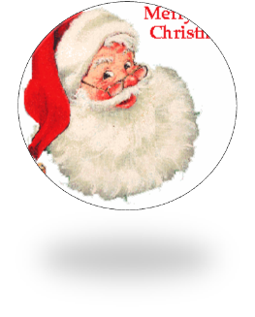

Who’s got the beard that’s long and white?
Santa’s got the beard that’s long and white.
Who comes around on a special night?
Santa comes around on a special night.
Special night, beard that’s white.
Must be Santa, must be Santa, must be Santa, Santa Claus.

Slide 7



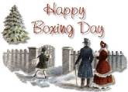

1. When do English people celebrate Christmas?
2. What day comes after Christmas?
3. What day is before Christmas?
Christmas Eve

Slide 8

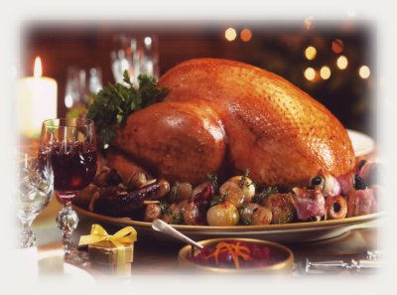
4. What bird is it?
Robin
5. What plant is it?
Holly
6. What do English people have for Christmas dinner?
Christmas turkey

Slide 9
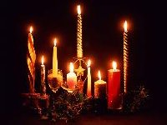
Спасибо за внимание !

