Slide 1
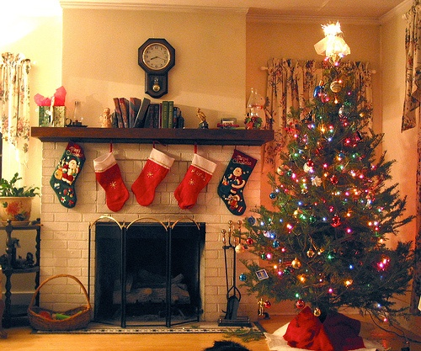
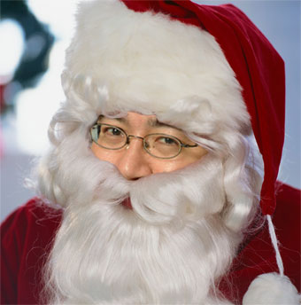
Winter holidays

Slide 2
The most important day of the holiday is 25 December, or Christmas Day.

Slide 3
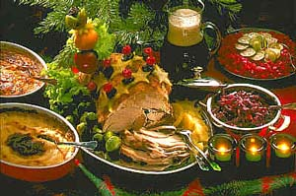
The word “Christmas” comes from the words “Christ’s Mass”-the celebration of the birth of Jesus Christ.

Slide 4
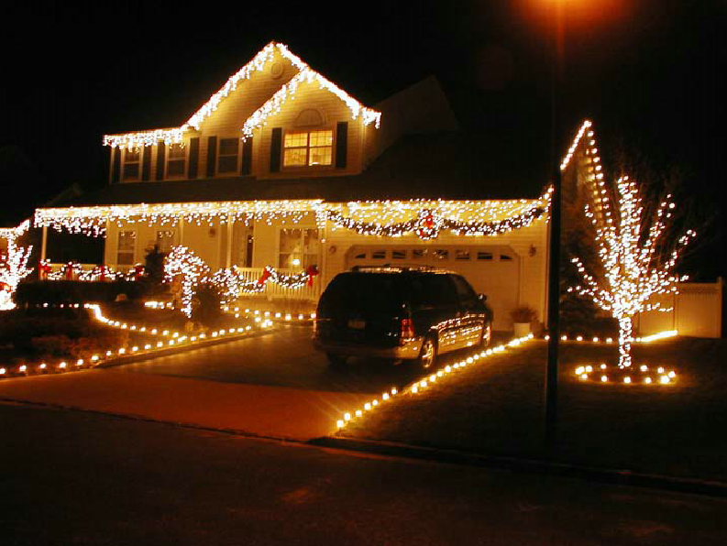
The most big cities, especially London, are decorated with coloured lights and Christmas trees.

Slide 5
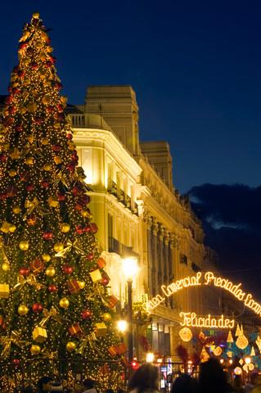
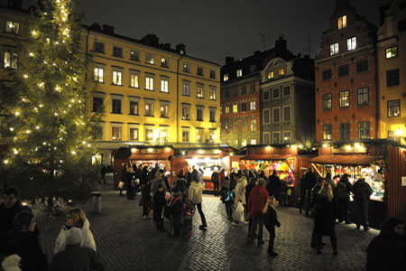
In Trafalgar Square in London in front of the National Gallery, stands an enormous Christmas tree.

Slide 6
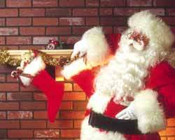
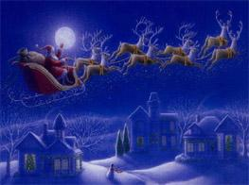
It is traditional custom in Britain for children to put stockings at the foot of their beds at Christmas for Santa Claus to fill them with presents.

Slide 7
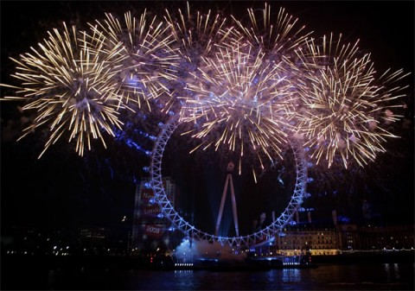
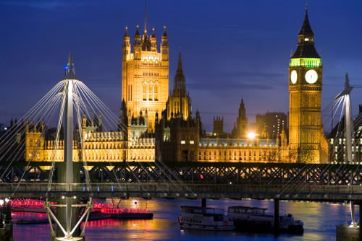
NEW YEAR

Slide 8
Santa Claus brings present on New Year Eve in Britain.

Slide 9
The traditional song on New Year Eve is Auld Lang Syne.

Slide 10
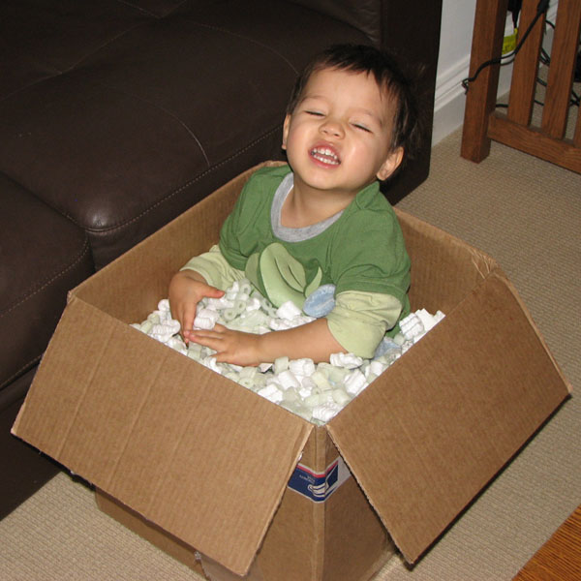
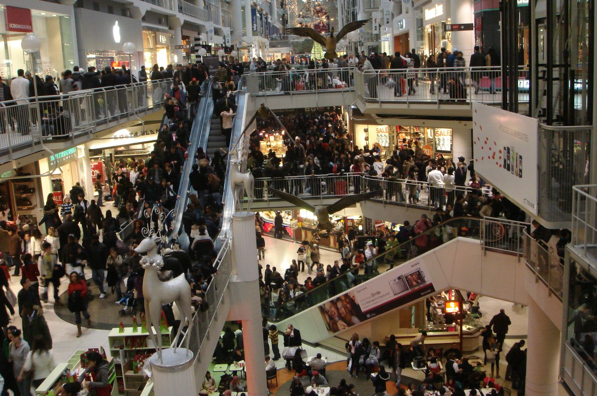
New Year has a special name Boxing day.

Slide 11
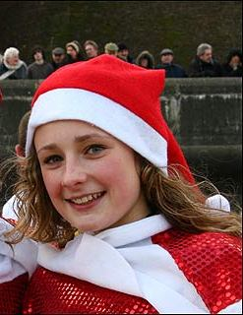
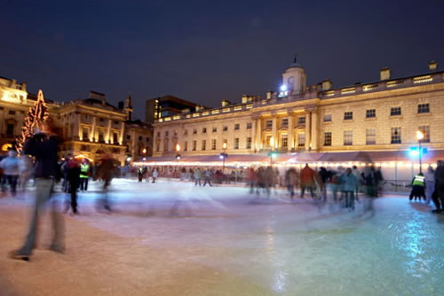
“First Footers” go from house to house after midnight bringing a piece of coal, a piece of bread, a silver coin.

